Slide 1
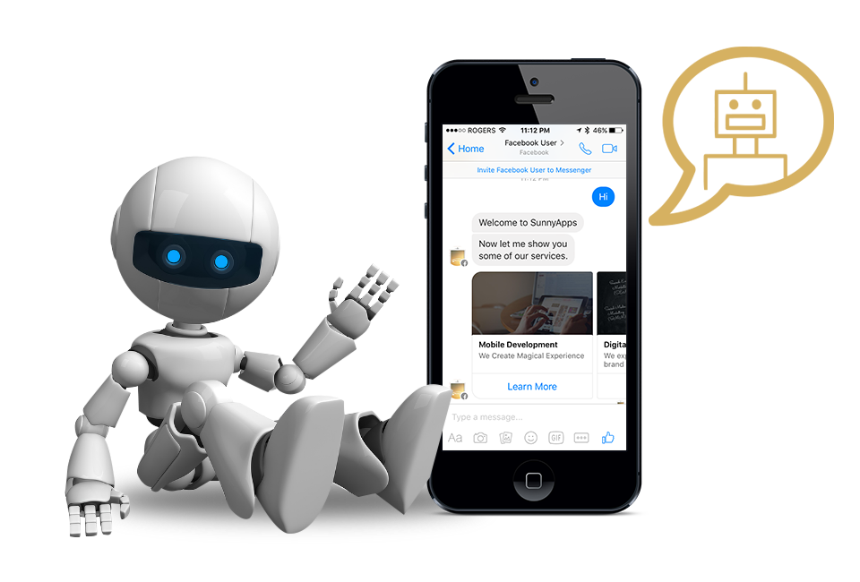
CBT Chatbot
Under the guidance of Prof. Aleena Swetapadma

Slide 2
Contents
Our Team
Introduction
Need of the hour
How it works
Technical Specifications
Libraries Used
Algorithms used
Looking ahead

Slide 3
Our Team
Abhijeet Sasmal
Avirup Mukherjee
Abhishek Kumar Pandey
Samarth Srivastava
Mohd Anas Khan

Slide 4
Introduction
Cognitive Behavioural Therapy is a talking therapy that help manage problems by changing the way a person thinks and behave. It is most commonly used for treating anxiety and depression and other mental and health problems. The chatbot designed uses a set of classifiers, natural language processing algorithms and neural nets to achieve this goal.

Slide 5
Need of the hour
Talking does help, especially under the guidance of licensed mental health professional. But therapy is expensive, inconvenient and often hard to approach. Here comes the role of AI chatbots equipped with advanced technology which provides a user friendly experience and enables user to hold human like conversation with the bot anonymously.

Slide 6
How it works
Following screenshots are taken from the working implementation of the project:

Slide 7
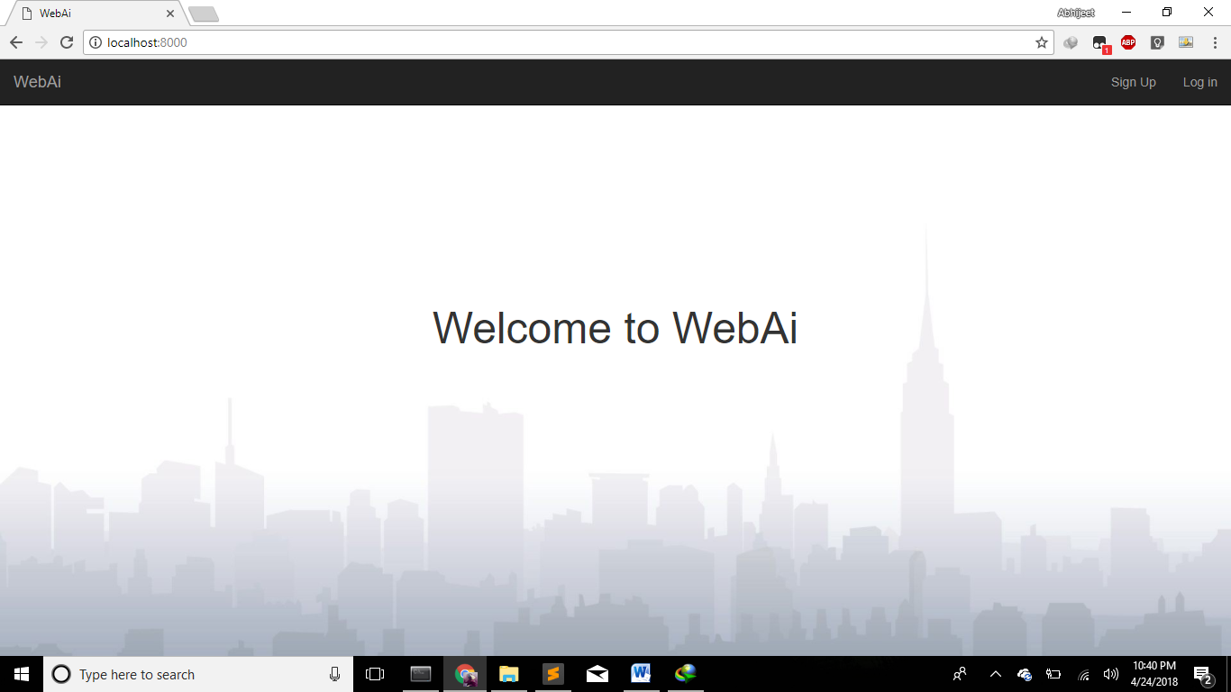

Slide 8
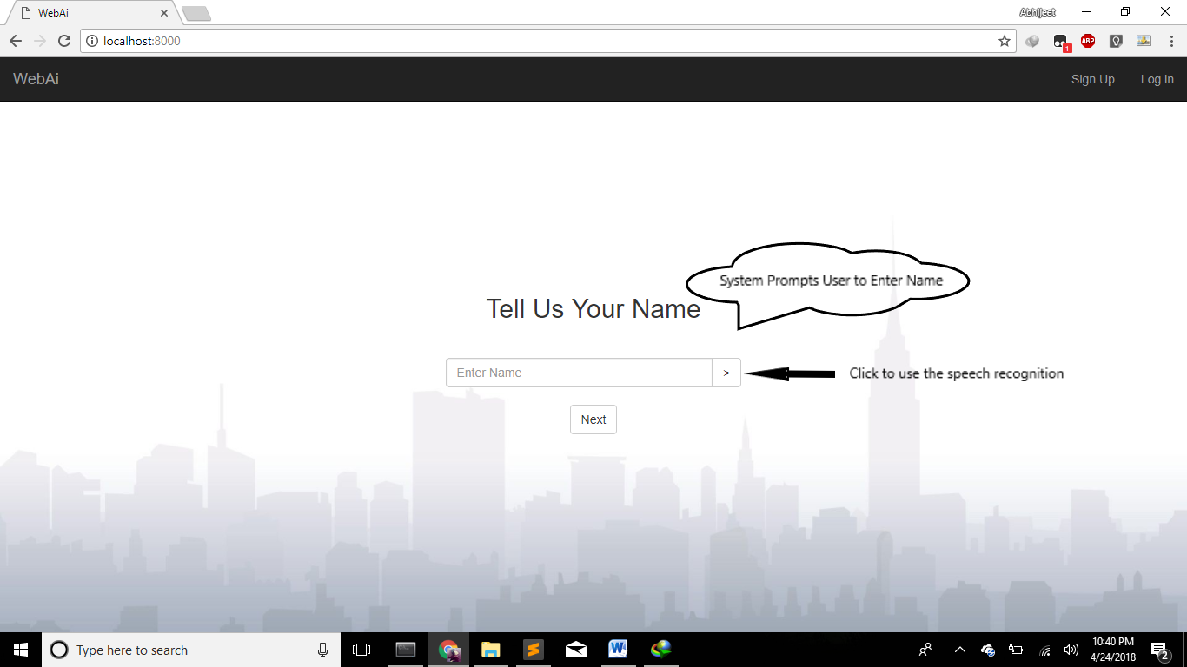

Slide 9
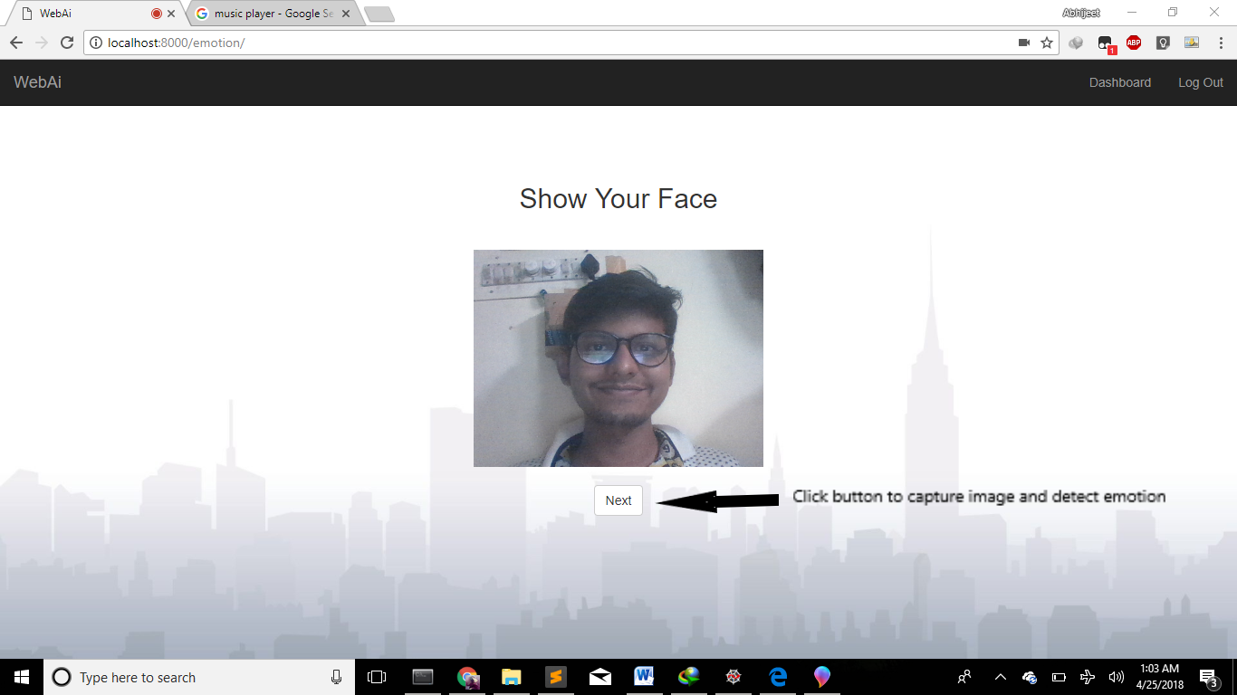
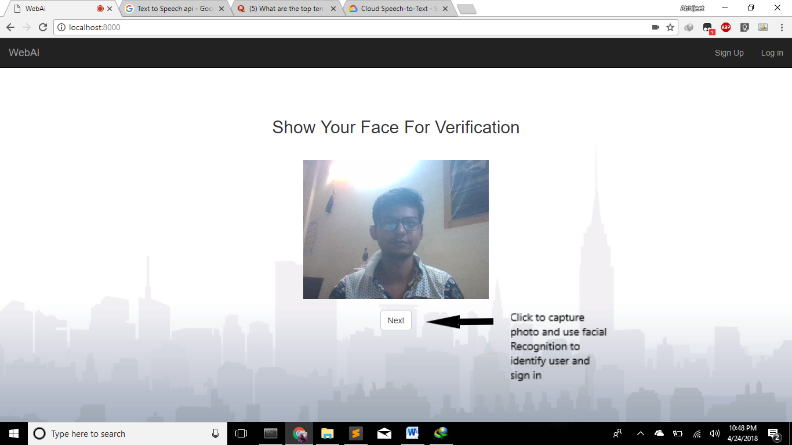

Slide 11
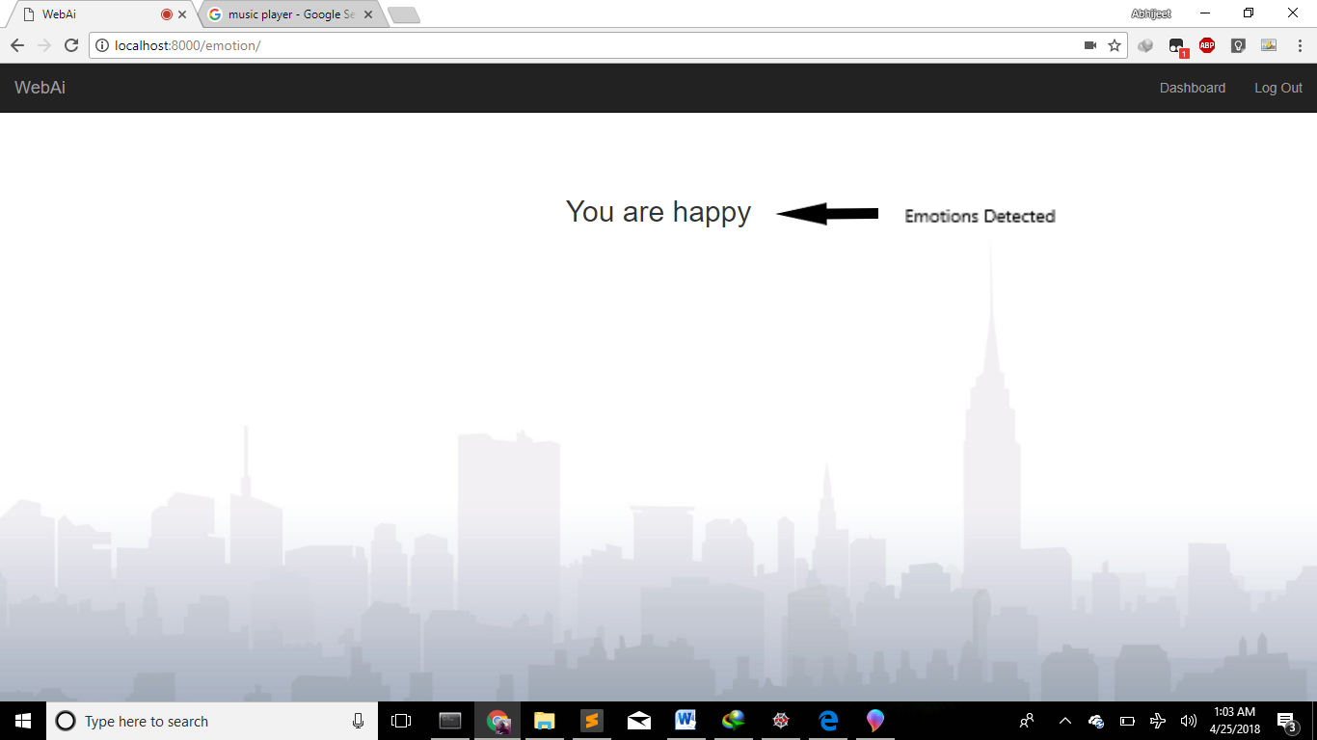

Slide 12
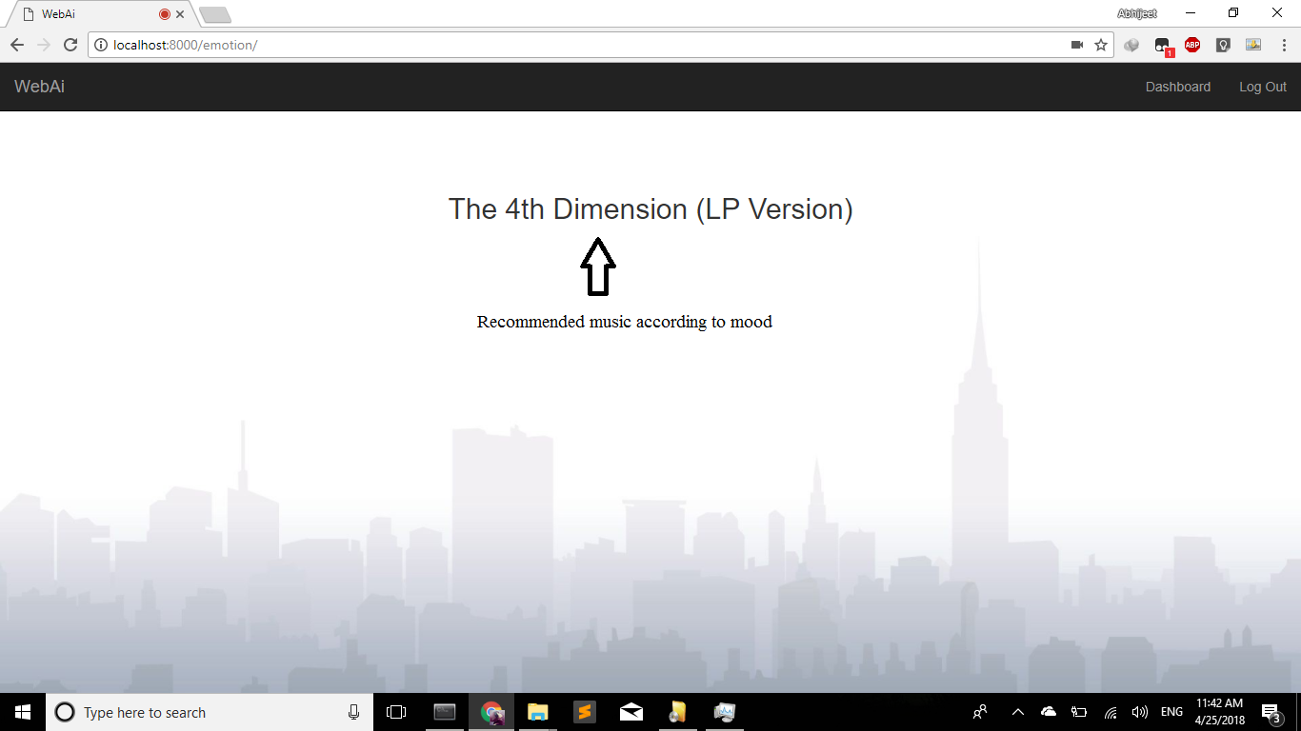

Slide 13
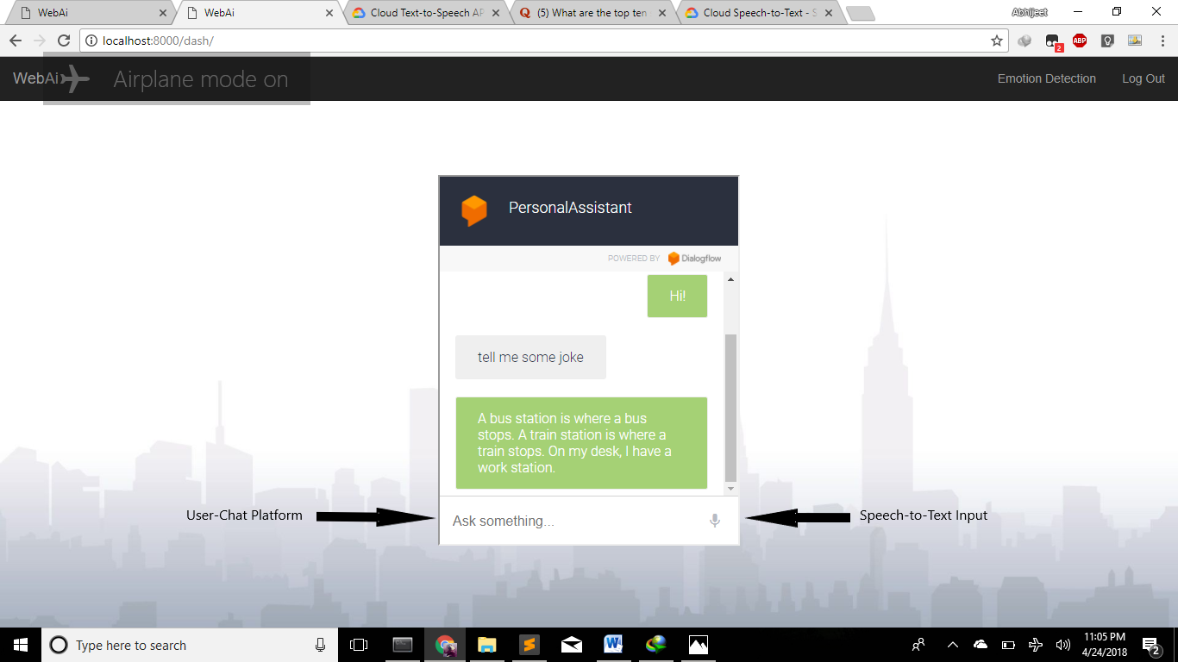

Slide 14
Technical Specifications
Python3
PyCharm
Jupyter Notebook
Spyder
Ngrok

Slide 15
Libraries used
Pandas
Numpy
Scikit-Learn
NLTK
OpenCV(cv2)
Pillow(Python Imaging Library)
Urllib
Flask
Json
Tensorflow
Theano
Keras

Slide 16
Algorithms used
LBPH (Local Binary Pattern Histogram Algorithm)
CNN (Convolution Neural Network)
Multinomial Naive Bayes Classifier
Count Vectorizer

Slide 17
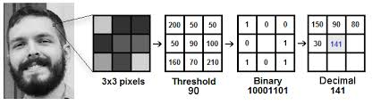
LBPH
Local Binary Pattern (LBP) is a simple yet very efficient texture operator which labels the pixels of an image by thresholding the neighborhood of each pixel and considers the result as a binary number.
Using the LBP combined with histograms we can represent the face images with a simple data vector.

Slide 18
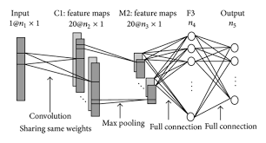
CNN
In machine learning, a convolutional neural network (CNN, or ConvNet) is a class of deep, feed-forward artificial neural networks that has successfully been applied to analyzing visual imagery.
CNNs use a variation of multilayer perceptrons designed to require minimal preprocessing.They are also known as shift invariant or space invariant artificial neural networks (SIANN), based on their shared-weights architecture and translation invariance characteristics.

Slide 19
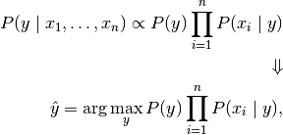
Multinomial Naive bayes Classifier
In machine learning, naive Bayes classifiers are a family of simple probabilistic classifiers based on applying Bayes' theorem with strong (naive) independence assumptions between the features.

Slide 20
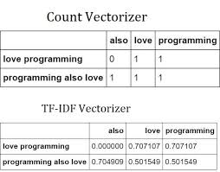
Count vectorizer
Converts a collection of text documents to a matrix of token counts. This implementation produces a sparse representation of the counts using scipy.sparse.csr_matrix.

Slide 21
References
Music mood Recommender :- ​https://github.com/rasbt/musicmood
https://dialogflow.com/docs/getting-started/basics
http://devdocs.io/tensorflow/
https://opencv.org/
https://github.com/opencv/opencv/blob/master/data/haarcascades/haarcascade_frontalface_defa ult.xml
WoeBot Therapy Chatboat by Andrew Ng: ​https://woebot.io/#features
Wysa Chatbot developed by ​Jo Aggarwal, Ramakant Vempati and team​: https://www.wysa.io/who-we-are
https://pypi.org/project/yahooweather/0.7/
https://dialogflow.com/docs/getting-started/basics
https://github.com/dialogflow

Slide 22
Looking Ahead
Large facial data, better feature selection and cleaning of data can give more accurate results.
More emotions including happy and sad can be identified like surprise,worry etc.
More features like movie recommendation, genre recommendation can be added on the basis of the mood identified.
More features in the chatbot can be added to make it more realistic and the intents regarding news, food ordering, traffic details etc can be added.

Slide 23
The End.
Thank You.

